Slide 1

Financial Risk Assessment
OSEON LEARNING PROJECT 1
BY AMOABENG YEBOAH

Slide 2
AGENDA
DATA DESCRIPTION
STATISTICAL SUMMARY
DATA TREND PATTERNS
VOLATILITIES
RELATIONSHIP BETWEEN THE CHANGES IN STOCK PRICES
CAPITAL ASSET PRICING MODEL
RISK ASSESSMENT
MODEL VISUALIZATION

Slide 3
DATA DESCRIPTION
Source of Data: Extracted live data from Yahoo Finance.
Time Period: Covers 5 years of stock data from 2018 to 2023.
Frequency: Daily stock values for detailed trend analysis.
Companies Analyzed:
Microsoft (MSFT)
Apple (AAPL)
Tesla (TSLA)
Market Index: S&P 500 values are included as a market benchmark.

Slide 4
DATA DESCRIPTION CON’T
Percentage Change Variable:
Calculated daily percentage change for individual stocks.
Represented as :
MS%chng for Microsoft
App%chng for Apple
Tesl%chng for Tesla.
S&P 500 Index:
Denoted as SP%chng, used to track the overall market performance.

Slide 5
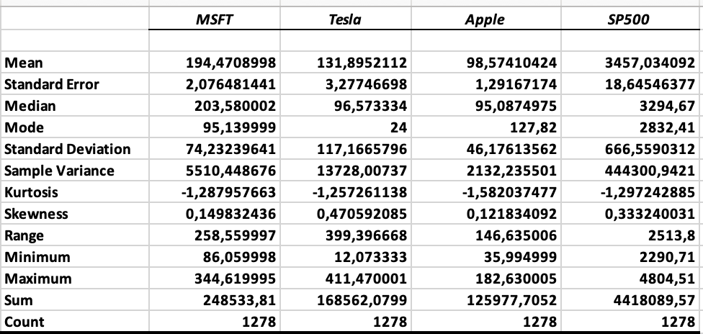
STATISTICAL SUMMARY
Tesla shows the highest volatility with the largest standard deviation, followed by MSFT, Apple, and the S&P 500.
MSFT has the highest average stock price, followed by Tesla and then Apple.
Based on skewness and kurtosis:
MSFT and Apple show a more stable price range with fewer extreme values
While Tesla exhibits more variability and potential for extreme values.

Slide 6
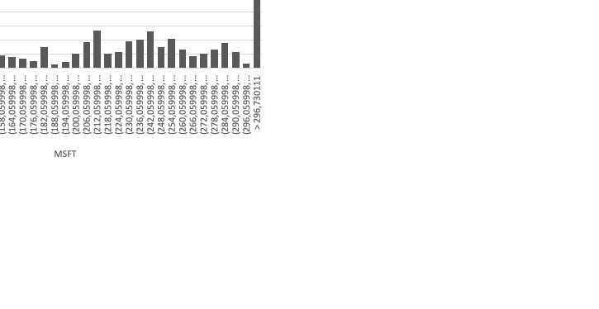
MSFT (Microsoft Corporation)
Positive skewness (0.14) suggests the distribution tails off to the right
There are a number of unusually high values.
Negative kurtosis (-1.28) suggests fewer extreme outliers than a normal distribution.
Platykurtic curve

Slide 7
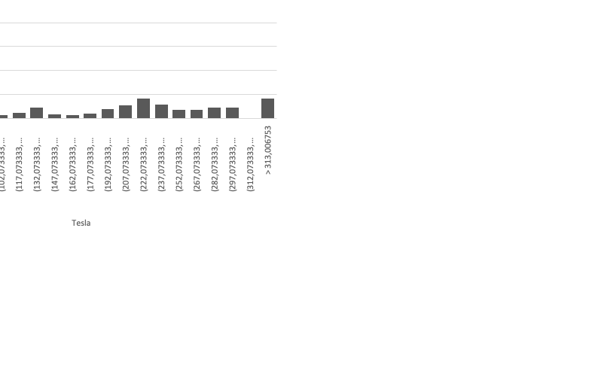
Tesla
Skewness: Positive (0.47) shows a right tail, similar to MSFT but more pronounced.
Kurtosis: Negative (-1.25) implies less likelihood of extreme outliers.
Platykurtic curve

Slide 8
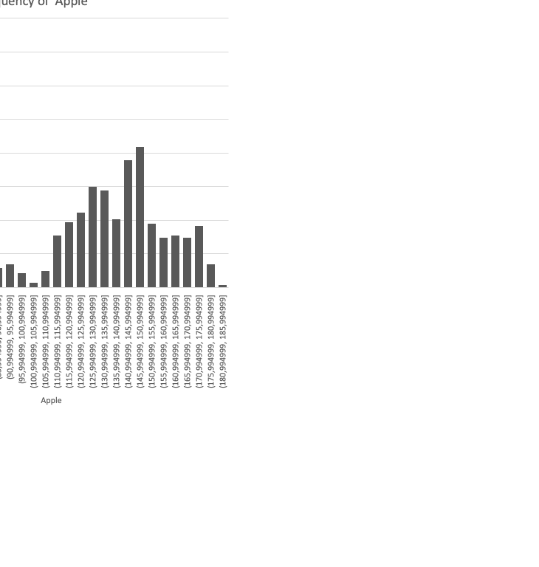
Apple
Skewness: Slightly positive (0.12), showing a gentle right tail.
Kurtosis: Negative (-1.58), implying a flatter distribution with fewer outliers.
Platykurtic curve

Slide 9
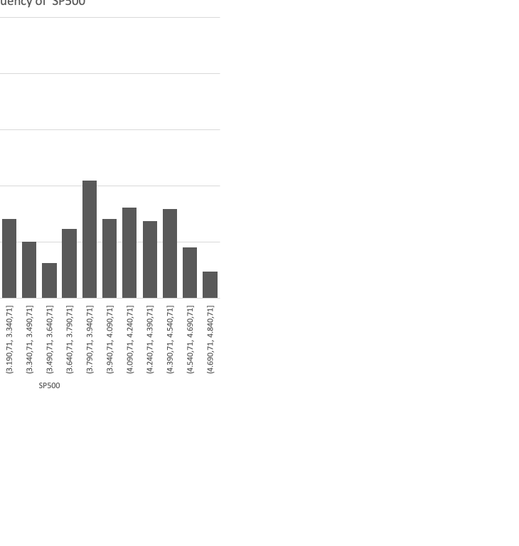
S&P 500 (SP500)
Skewness: Positive (0.33), indicating a longer right tail.
Kurtosis: Negative (-1.29), suggesting the index has a flatter peak compared to the normal distribution.
Platykurtic curve

Slide 10
DATA TREND
Tesla (orange line): Displays significant volatility
Microsoft (MSFT - blue line) and Apple (gray line): Show growth with less volatility compared to Tesla.

Slide 11
VOLATILITIES
Tesla's line shows the highest peaks and troughs,
indicating that it has the most significant daily percentage changes,
reflective of high volatility.

Slide 12
S&P 500 (%chg)
stationary
on most days, the percentage change is minimal.
There are no extreme outliers
which indicates a stable market index without extreme volatility.

Slide 13
Tesla (%chg)
stationary
more spread along the y-axis compared to the S&P 500.
This indicates that Tesla's daily percentage changes are more volatile
consistent with the nature of individual stocks as opposed to market indices.

Slide 14
Apple (%chg)
Similarly, plot points are concentrated around the zero line.
The spread is slightly more than the S&P 500,
suggesting mild volatility, but less than Tesla
indicating a relatively stable performance for a large-cap stock.

Slide 15
Microsoft (%chg)
The points for Microsoft show a distribution pattern similar to Apple
With most of the data clustered close to the zero line.
It indicates stability
But with some days of notable percentage changes.

Slide 16
RELATIONSHIP BETWEEN THE CHANGES IN STOCK PRICES

Slide 17
RELATIONSHIP BETWEEN THE CHANGES IN STOCK PRICES

Slide 18
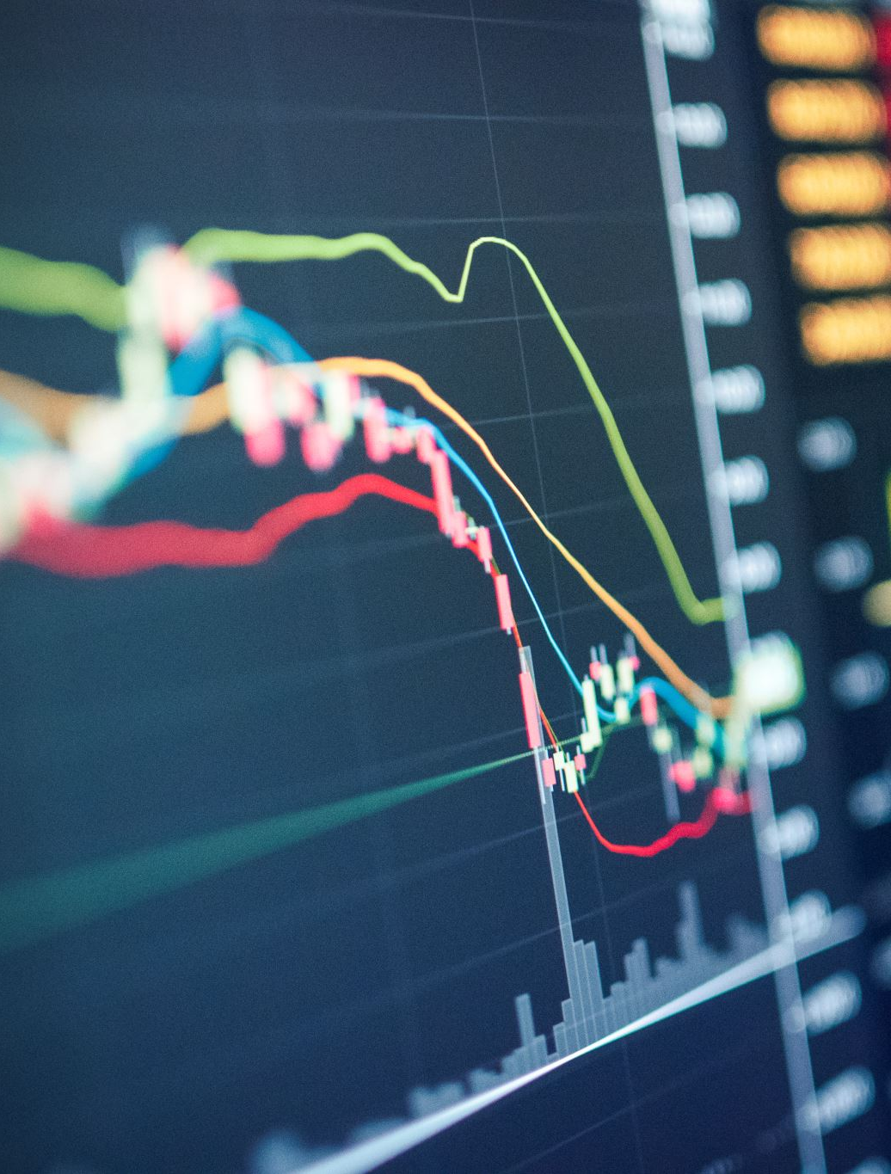
CAPITAL ASSET PRICING MODEL
Utilizes the slope coefficient Beta from regression analysis
Beta measures the relative risk of stocks in comparison to the market.
Higher beta values indicate higher risk and expected higher returns.
Regression Model:
Analyzes the relationship between stock returns (%chng) and market return (SP%chng).
A separate model for each company to determine individual stock behaviors.

Slide 19
RISK ASSESSMENT
Beta Values: All three stocks have a beta greater than 1
suggesting they are all more volatile than the market.
Assessment:
Microsoft exhibits lower risk with a beta of 1.2138.
Apple shows moderate risk correlating with its beta of 1.3293.
Tesla stands out with the highest risk, as indicated by its beta of 1.8183.
Coefficients | MS%chng | Tesl%chng | App%chng
SP%chng | 1.2138 | 1.8183 | 1.3293

Slide 20
MODEL VISUALIZATION

Slide 21

THE END

